Slide 1


ZippyPark
Problem & Solution
c
Demo 1 Overview
An optimized automated parking garage.
c
Product
Roadmap
Team 2: Samantha Moy, Atmika Ponnusamy, Samantha Cheng, Kylie Chow, Andrew Ko, Parth Patel, Shreya Patel, Nandita Shenoy, Piotr Zakrevski
c
Future Plans

Slide 2
Problem & Solution
Problem
Standard parking garages are…
Inefficient
Cost ineffective
Impersonal
Difficult to manage
Solution
ZippyPark parking garages provide customers & owners with...
Reservation & walk-in system
Adjustable pricing scheme
Point reward system
Managerial hub
c
Demo 1 Overview
c
Product
Roadmap
c
Future Plans

Slide 3
Product Preview
Problem & Solution
Customer Mobile App
Garage Sensors
Manager Website
Demo 1 Overview
UC 1 - Create Account.
UC 2 - Edit Account.
UC 4 - Create Reservation.
UC 5, 6
UC 7 - Enter Garage.
UC 8 - Exit Garage.
UC 9 - Update Spot Status.
UC 3 - Delete Account.
UC 5 - Edit Reservation.
UC 6 - Cancel Reservation.
UC 10, 11, 12
Product
Roadmap
ZIPPYPARK - DEMO 1
c
1 shared MySQL database ・ 3 subsystems ・ 9 of 12 use cases
Future Plans

Slide 4
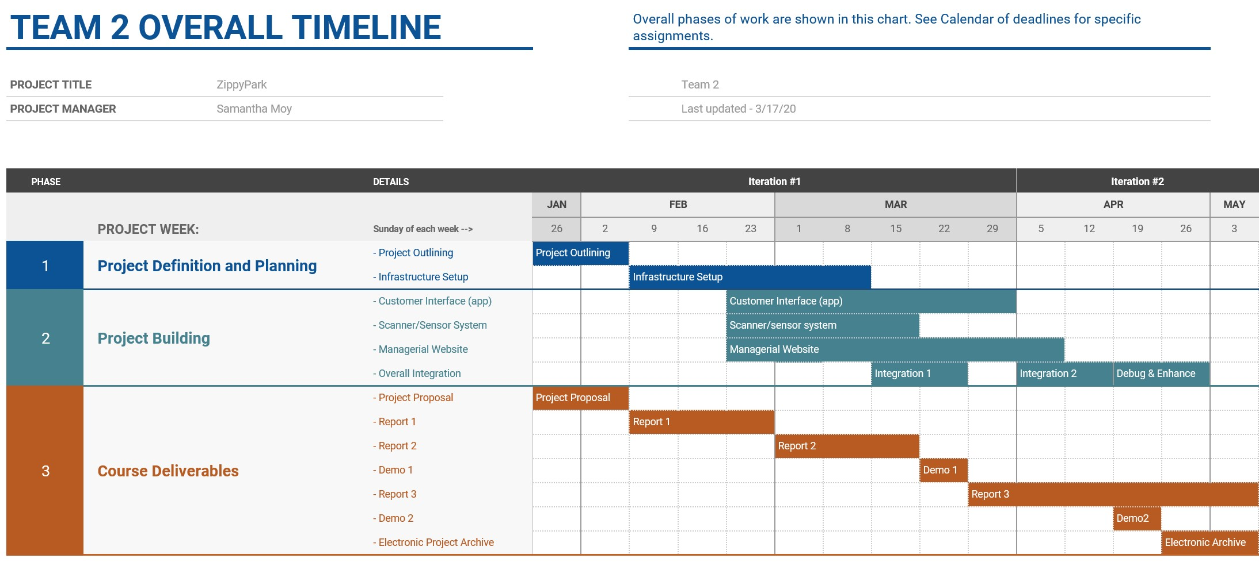
Problem & Solution
Demo 1 Overview
Product
Roadmap
c
Future Plans
May also be viewed at https://tinyurl.com/team2Gantt

Slide 5
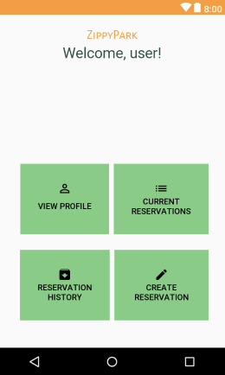
More to come...
Problem & Solution
UC 10 - Display Statistics
UC 11 - Points Management
UC 12 - Payment
Refined managerial hub
Reservation history feature
Point reward selection
Demo 1 Overview
Product
Roadmap
Future Plans

